Slide 1
VALUES
ATTITUDES
&
JOB SATISFACTION

Slide 2
Value
Values represents basic convictions (certainty) that “a specific mode of conduct or end-state of existence is personally or socially preferable to an opposite or converse mode of conduct or end-state of existence”.
Carries an individual’s opinion as to what is ‘right’, ‘wrong’, ‘good’ or ‘desirable’, etc..
Values have both Intensity and Content
Content refers to whether a ‘mode of conduct’ is important
Intensity refers to ‘how important’ is that mode of conduct.

Slide 3
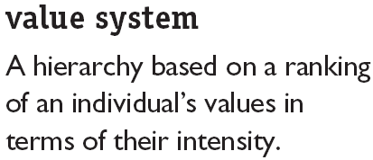
A significant portion of our values are stable and enduring. Established from our early years …from parents, teachers, society, others.
In other words, our values are generally not flexible.

Slide 4
Why are values important?
Foundation for understanding people’s motivation and attitudes
Values influences our perceptions
The values one carries can ‘cloud’ an individual’s objectivity and rationality.

Slide 5

Approaches towards classifying values
Rokeach Value Survey (Milton Rokeach)
Consists of two sets of values with each set containing 18 individual items

Slide 6
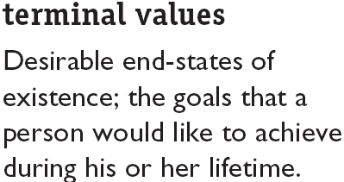
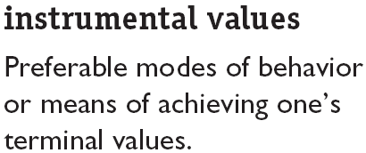
Rokeach Value Survey

Slide 7
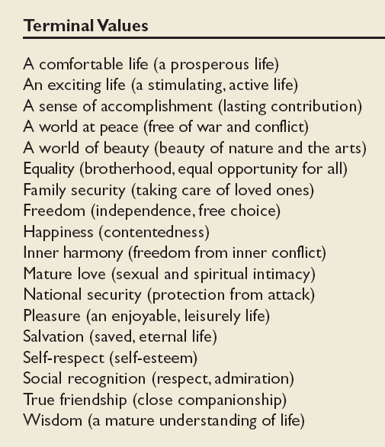
Values in the Rokeach Survey

Slide 8
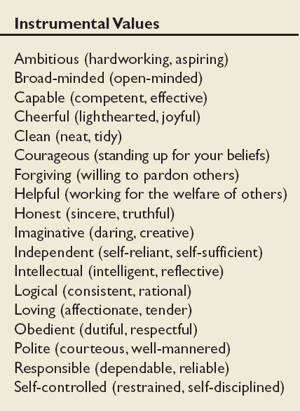
Values in the Rokeach Survey
(cont’d)

Slide 9
RVS values differs among groups
People in the same group or occupation tend to have similar values.
Differences can become a problem area (conflicts) especially in negotiations

Slide 10
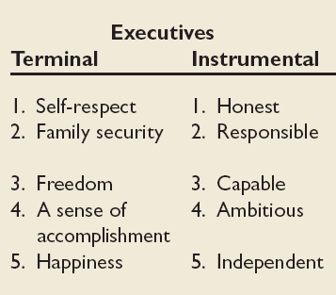
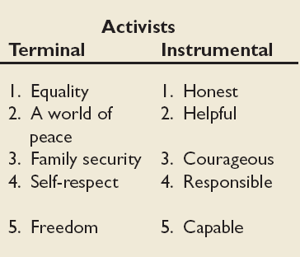
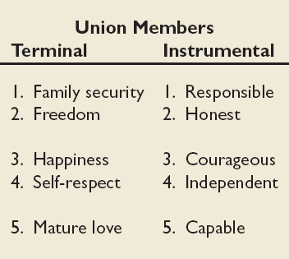
Mean Value Rankings of Executives, Union Members, and Activists

Slide 11
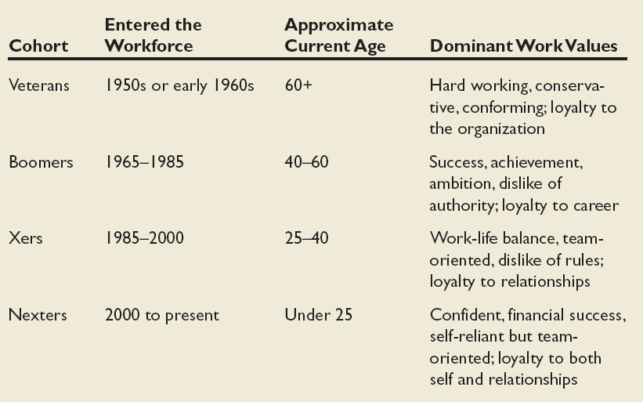
Dominant Work Values in Workforce

Slide 12
Values, Loyalty, and Ethical Behavior
Ethical Climate in
the Organization
Ethical Values and Behaviors of Leaders

Slide 13
Geert Hofstede’s Five Value Dimensions (1970s)
Values differs across cultures... Therefore there is a need to understanding these differences to better predict behaviour
Hofstede’s : Widely used approach for analysing variations among cultures. Study of 116,000 IBM employees across 40 countries.
Result? Managers and employees vary on 5 value dimensions of national culture
Power Distance
Individualism versus Collectivism
Quantity of life and Quality of Life
Uncertainty Avoidance
Long-term versus Short-term Orientation

Slide 14
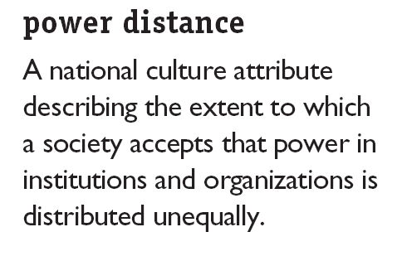
Hofstede’s Framework for Assessing Cultures
High Rating = large inequalities of power and wealth exists and is tolerated in the culture
Low Rating = stresses on equality and opportunity

Slide 15
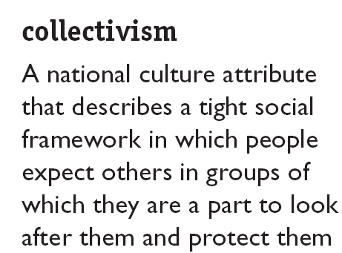
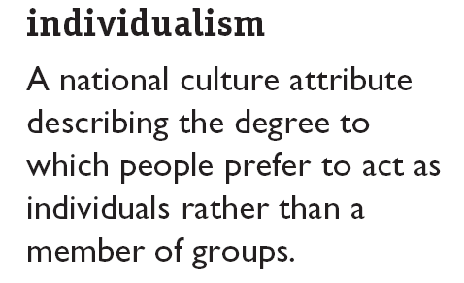

Hofstede’s Framework (cont’d)

Slide 16

Hofstede’s Framework (cont’d)
Masculinity
Degree to which a culture favours traditional masculine roles (achievement, power, control) versus a culture that views men and women as equals
Has separate roles for men and women with men dominating
Femininity
Little differentiating between male and female roles. More equality between men and women

Slide 17
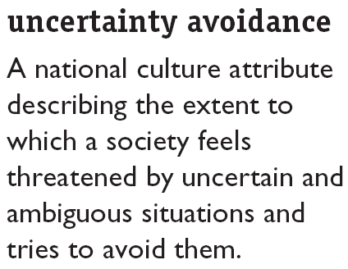

Hofstede’s Framework (cont’d)
Degree to which people prefer structure over unstructured situations
Tend to emphasise laws, regulations, controls, to reduce uncertainty

Slide 18

Hofstede’s Framework (cont’d)
Long term orientation
Looking to the future and value thrift, persistence and tradition
Short term orientation
People value the here-and-now.
Readily accept change

Slide 19
Hofstede’s cultural values by nation
country | power distance |  | indiv vrs coll |  | masc vrs fem |  | uncer avoid |  | long vrs short term
 | index | rank | index | rank | index | rank | index | rank | index | rank
Australia | 36 | 41 | 90 | 2 | 61 | 16 | 51 | 37 | 31 | 22
Denmark | 18 | 51 | 74 | 9 | 16 | 50 | 23 | 51 | 46 | 10
UK | 35 | 42 | 89 | 3 | 66 | 9 | 35 | 47 | 25 | 28
Japan | 54 | 33 | 46 | 22 | 95 | 1 | 92 | 7 | 80 | 4
Malaysia | 104 | 1 | 26 | 36 | 50 | 25 | 36 | 46
Singapore | 74 | 13 | 20 | 39 | 48 | 28 | 8 | 53 | 48 | 9
India | 77 | 8 | 48 | 21 | 56 | 20 | 40 | 45 | 61 | 7
score range: 0 = extremely low, 100 = extremely high

Slide 20
Criticism of Hofstede’s Research
Original data is 30 years old
  a lot has happened since then
Conducted only in one company (IBM)

Slide 21
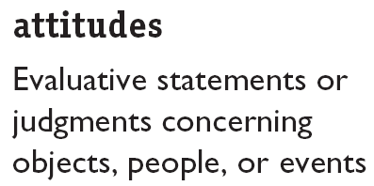
Attitude

Slide 22
neutral objects questionnaire
HOW SATISFIED ARE YOU?
city in which you live satisfied neutral dissatisfied
neighbours you have satisfied neutral dissatisfied
high school you attended satisfied neutral dissatisfied
Climate where you live satisfied neutral dissatisfied
movies produced today satisfied neutral dissatisfied
quality of food you buy satisfied neutral dissatisfied
cars today satisfied neutral dissatisfied
local newspaper satisfied neutral dissatisfied
your first name satisfied neutral dissatisfied
people you know satisfied neutral dissatisfied
telephone service satisfied neutral dissatisfied
8 ½' x 11' paper satisfied neutral dissatisfied
restaurant food satisfied neutral dissatisfied
modern art satisfied neutral dissatisfied

Slide 23
Components of attitude
Cognitive = evaluation
My boss promoted X who deserved it less than me
Negative attitude towards boss
Affective = feeling
I dislike my boss
Behavioural = action
I’m looking for a new job
I’ve complained to anyone who will listen

Slide 24
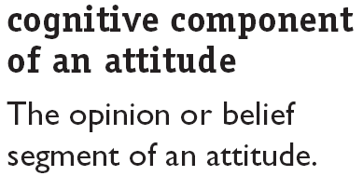
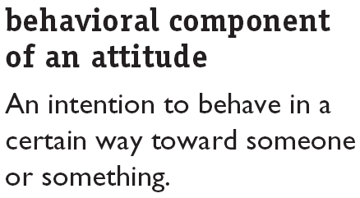
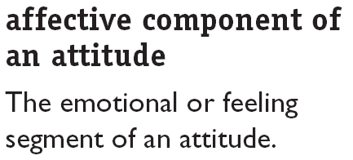
Attitudes, Contd.,

Slide 25
How consistent are attitudes?
People seek consistency in their attitude and behaviour
Cognitive dissonance (Leon Festinger)
  Any form of inconsistency is uncomfortable and individuals will try to reduce this dissonance.
  How?
    Depending on the importance of the dissonant element
    Degree of influence individual has over this element
    Reward involved in the reduction of dissonance

Slide 26
Types of Attitudes
Job Satisfaction
Job Involvement
Organizational Commitment
job satisfaction
Job satisfaction refers to an individual’s general attitude toward his or her job. A person with a high level of job satisfaction holds positive attitudes toward the job, while a person who is dissatisfied with his or her job holds negative attitudes about the job.

Slide 27
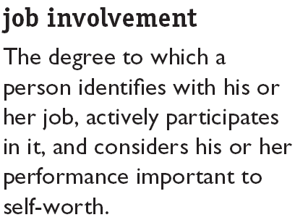
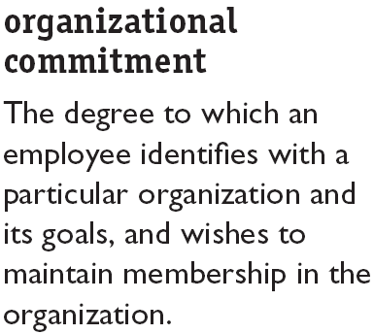


Types of Attitudes

Slide 28


Attitude-Behavior Relationship
Recent research indicates that the attitudes (A) significantly predict behaviors (B) when moderating variables are taken into account.
Moderating Variables
Behavioral Influence
Importance
Specificity
Accessibility
Social pressures
Direct experience
High
Low

Slide 29
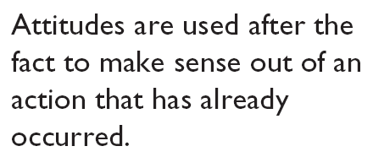

Self-Perception Theory for Measuring A-B Relationship
When asked about an attitude toward some object, individuals recall their behavior relevant to that object and then infer their attitude from their past behavior.

Slide 30
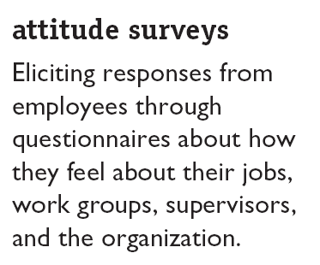

An Application: Attitude Surveys
The preceding review indicates that a knowledge of employee attitudes can be helpful to managers in attempting to predict employee behavior.

Slide 31
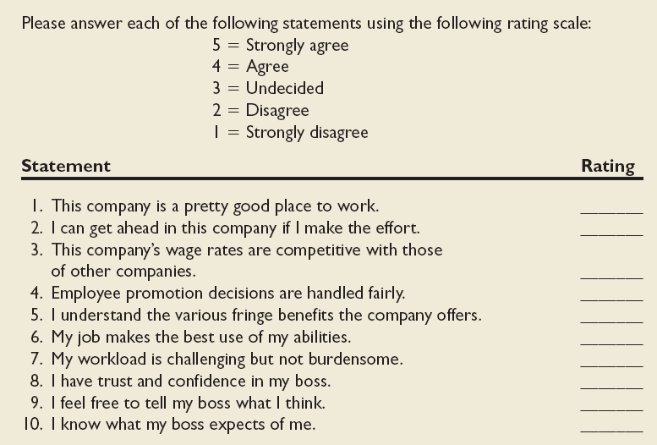
Sample Attitude Survey

Slide 32
Job Satisfaction
  Single Global Rating Method
  Single global rating method is nothing more than asking individuals to respond to one question, such as, “ All things considered, how satisfied are you with your job?” The respondents then reply by circling a number between 1 and 5 that corresponds to answers from “highly satisfied” to “highly dissatisfied”.
  Summation Score Method
  It is a more sophisticated method. It identifies key elements in a job and asks for the employees feelings about each. Typical factors that would be included are the nature of the work, supervision, present pay, promotion opportunities, and relations with workers.

Slide 33
The Effect of Job Satisfaction on Employee Performance
Satisfaction and Productivity
  Satisfied workers aren’t necessarily more productive.
  Worker productivity is higher in organizations with more satisfied workers.
Satisfaction and Absenteeism
  Satisfied employees have fewer avoidable absences.
Satisfaction and Turnover
  Satisfied employees are less likely to quit.
  Organizations take actions to cultivate high performers and to weed out lower performers.

Slide 34

Job Satisfaction and OCB
Satisfaction and Organizational Citizenship Behavior (OCB)
  Satisfied employees who feel fairly treated by and are trusting of the organization are more willing to engage in behaviors that go beyond the normal expectations of their job.

Slide 35
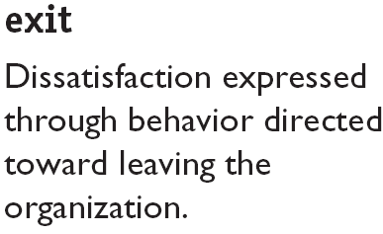
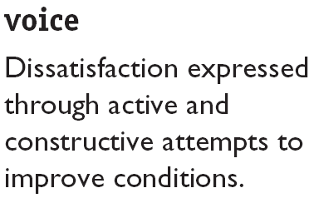
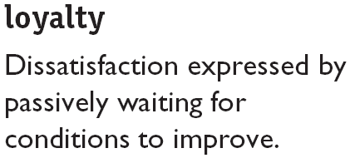
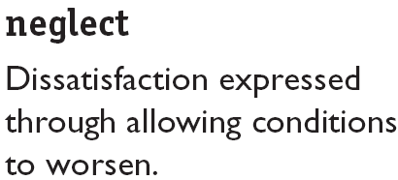
How Employees Can Express Dissatisfaction

Slide 36
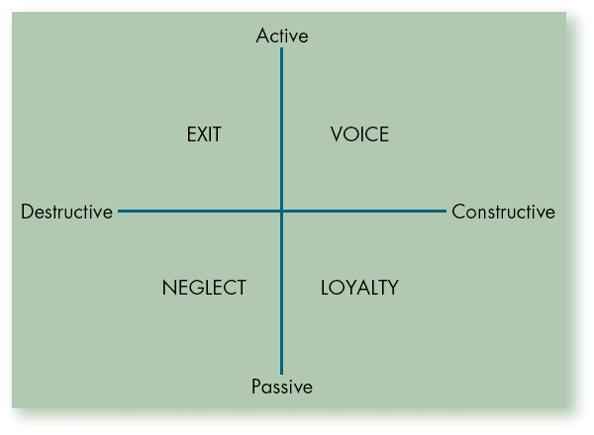
Responses to Job Dissatisfaction

